Slide 1
nRF51822 Features
32-bit ARM Cortex M0 processor
256kB flash/ 16 kB RAM
31 GPIO pins
2 SPI channels
2.4 GHz radio
Programmable output power +4dBm to -20dBm
Tx and Rx radio can be enable separatly
16 MHz oscillator
GFSK Modulation
2 Mbps maximum On-air data rate
-85dBm at 2 Mbps sensitivity
Selectable peripheral module On/OFF
2 uA when all peripherals in IDLE and CPU OFF

Slide 2
nRF51822 Characteristic
Electrical Characteristic (Processor)
VDD = 3.0v
I @ 16MHZ running off flash memory = 4.4 mA
Electrical Characteristic (Radio 2.4 ghz)
VDD = 3.0v
Tx Current @ +4dbm = 16 mA
Tx Current @ -16dbm = 6 mA
Rx Current @ 1 mbps = 13 mA
Electrical Characteristic (SPI)
VDD = 3.0v
Current @ 125kbps = 180 uA
Current @ 8 Mbps = 200 uA
Mechanical Characteristic
L x W x H = 6 x 6 x .85 (mm)

Slide 3
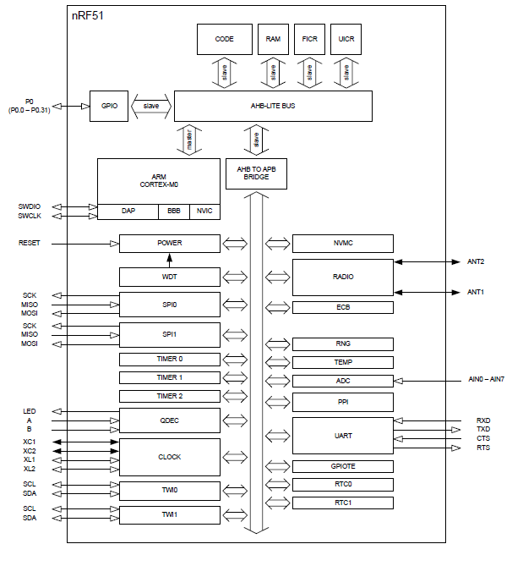
nRF51822 Block Digram

